Slide 1

Aula Magna
Aula 07
2 TDSPN
Python, K-NN, e reconhecimento de caracteres

Slide 2
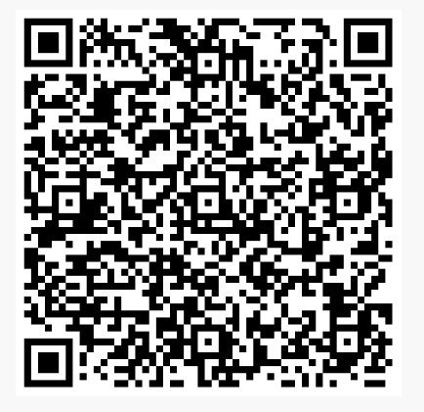
Chamada

Slide 3
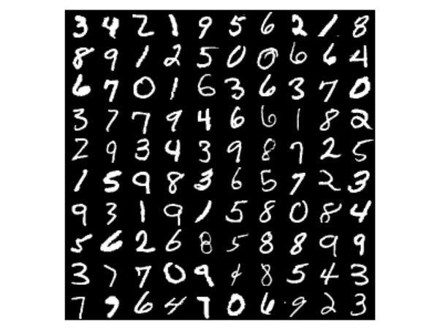

Slide 4
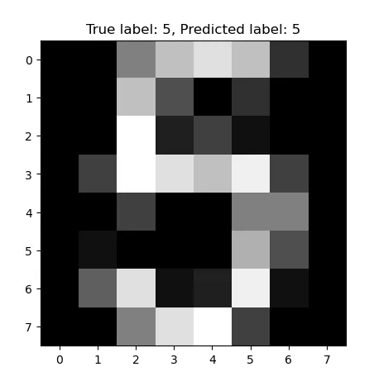

Slide 5
from sklearn.datasets import load_digits
# Load data
digits = load_digits()
X = digits.images
y = digits.target
_, axes = plt.subplots(2, 5, figsize=(10, 5))
axes = axes.ravel()
for ax, image, label in zip(axes, digits.images, digits.target):
ax.imshow(image, cmap=plt.cm.gray_r, interpolation="nearest")
ax.set_title("Training: %i" % label)
plt.subplots_adjust(wspace=0.5)

Slide 6

Reconhedimento de caracteres

Slide 7
# Bibiloteca Standard Cientifica de Python
import matplotlib.pyplot as plt
# Import datasets, classificadores e metricas de performance
from sklearn import datasets, metrics, svm
from sklearn.model_selection import train_test_split

Slide 8
digits = datasets.load_digits()
_, axes = plt.subplots(nrows=1, ncols=4, figsize=(10, 3))
for ax, image, label in zip(axes, digits.images, digits.target):
ax.set_axis_off()
ax.imshow(image, cmap=plt.cm.gray_r, interpolation="nearest")
ax.set_title("Treinando: %i" % label)

Slide 9
# flatten das imagens
n_samples = len(digits.images)
data = digits.images.reshape((n_samples, -1))
# Creando um classificador
clf = svm.SVC(gamma=0.001)
# Split data into 50% train and 50% test subsets
X_train, X_test, y_train, y_test = train_test_split(
data, digits.target, test_size=0.5, shuffle=False)
# Learn os digits e treinar com o SubDataset
clf.fit(X_train, y_train)
# Fazer a Predicao
predicted = clf.predict(X_test)

Slide 10
_, axes = plt.subplots(nrows=1, ncols=4, figsize=(10, 3))
for ax, image, prediction in zip(axes, X_test, predicted):
ax.set_axis_off()
image = image.reshape(8, 8)
ax.imshow(image, cmap=plt.cm.gray_r, interpolation="nearest")
ax.set_title(f"Predicao: {prediction}")

Slide 11
print(
f"Classification report for classifier {clf}:\n"
f"{metrics.classification_report(y_test, predicted)}\n"

Slide 12
disp = metrics.ConfusionMatrixDisplay.from_predictions(y_test, predicted)
disp.figure_.suptitle("Confusion Matrix")
print(f"Confusion matrix:\n{disp.confusion_matrix}")
plt.show()

Slide 13
# colocar em uma matriz a tabela de treino e teste
y_true = []
y_pred = []
cm = disp.confusion_matrix
# Para cada celula colocar uma classificacao de acordo com a acuracia de predicao
for gt in range(len(cm)):
for pred in range(len(cm)):
y_true += [gt] * cm[gt][pred]
y_pred += [pred] * cm[gt][pred]
print(
"Classificaco report recriada atraves da matriz de confusao :\n"
f"{metrics.classification_report(y_true, y_pred)}\n"
)

